Slide 1
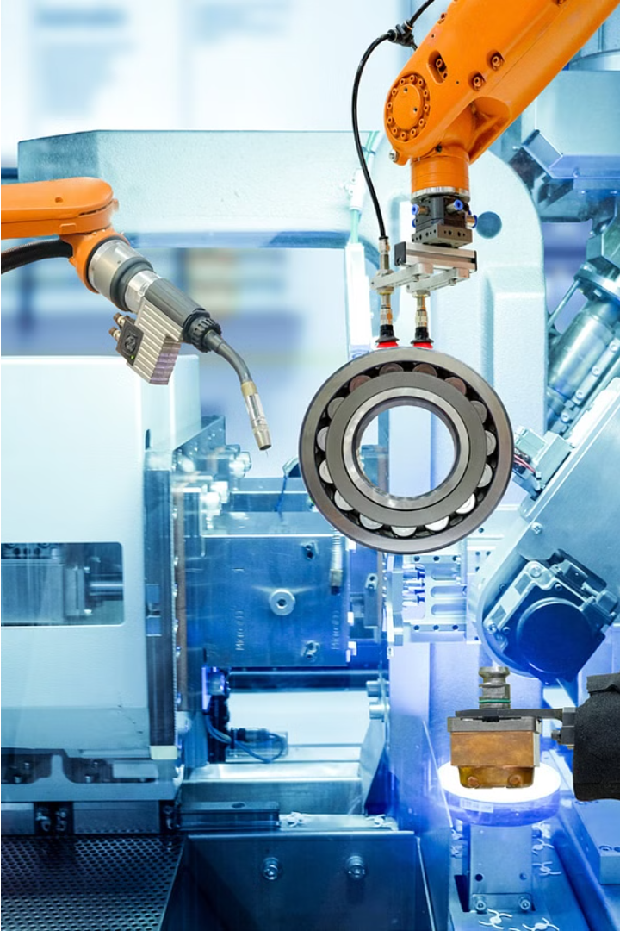
Transferring Data from PLC to Grafana
In today's industrial landscape, efficient monitoring and analysis of machine data are paramount for optimizing operations, ensuring productivity, and minimizing downtime. This project addresses the challenge of accessing and visualizing data from PLCs, the backbone of industrial automation, by providing a robust solution that extracts data, transforms it, and presents it through an intuitive web interface.
Va
Presented By :-
Raavee Umale
Vinit Tarhekar
Gayatri Padolkar
Aditi Wandale

Slide 2
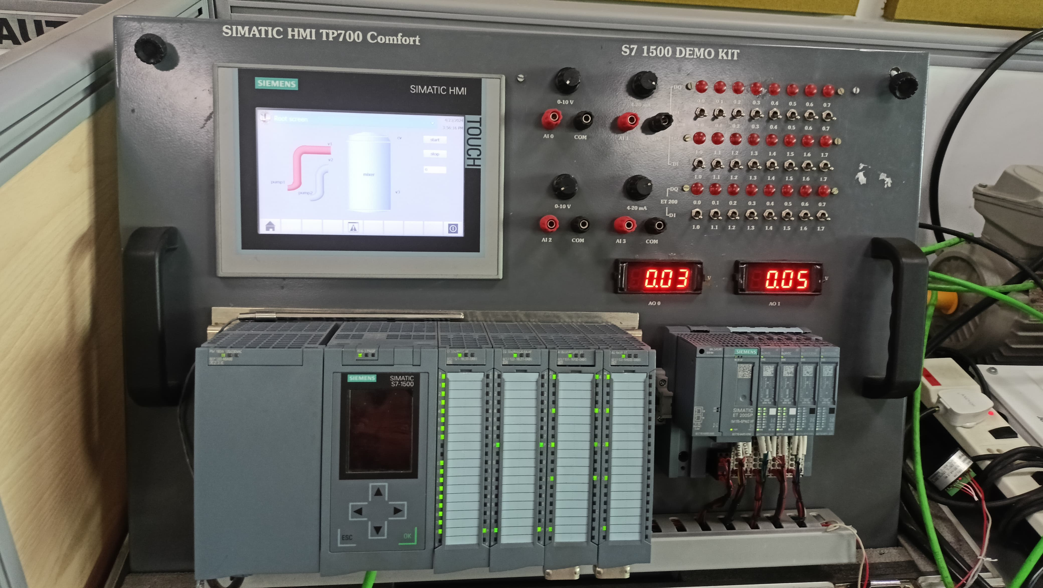
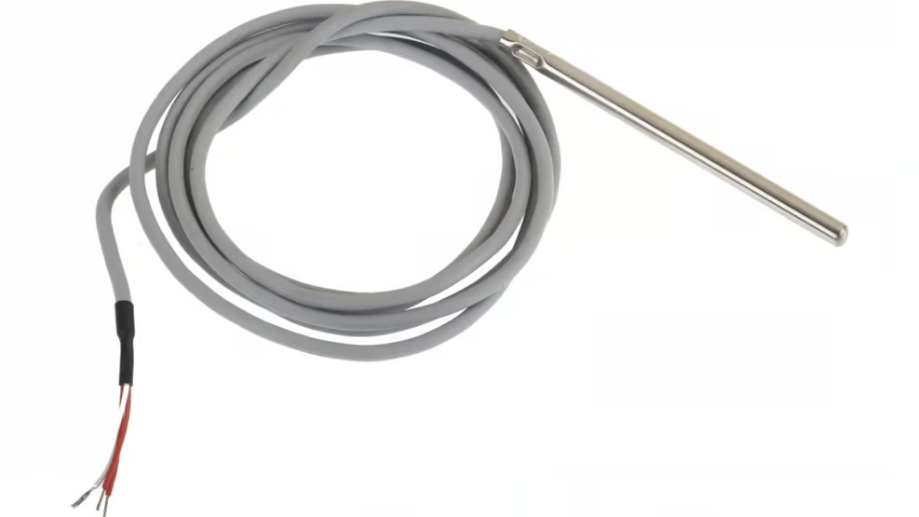
Components Used
Hardware
The project utilizes the following hardware components:
Siemens S7-1500 PLC
RTD (Resistance Temperature Detector)
Software
The project leverages the following software components:
TIA Portal V.16
UAExpert
Node-RED
InfluxDB Cloud
Grafana Cloud

Slide 3


Schematic Process
PLC
Siemens TIA Portal V16 is used to program the PLC, configure the OPC UA server, and ensure compatibility with the industrial automation system.
1
UAExpert
UAExpert serves as the bridge between Node-RED and the PLC, facilitating communication through the OPC UA protocol and enabling seamless data exchange.
2
Node-RED
Node-RED provides a visual programming interface for connecting data sources, processing data, and sending it to Grafana for visualization.
3
Influx DB
Grafana
Grafana is a versatile open-source analytics and visualization platform that provides powerful tools for monitoring and analyzing diverse datasets in real-time.
Influx DB acts as the time-series database where the extracted PLC data is stored. Its efficient storage architecture and powerful query language make it ideal for handling large volumes of time-stamped data.
4
5

Slide 4
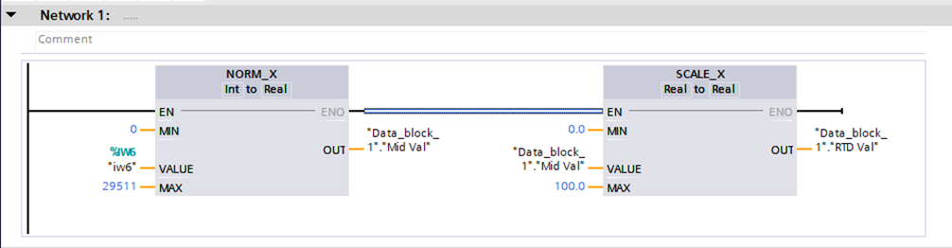
PLC Configuration with TIA Portal
1
Program Configuration
2
Runtime License
The PLC program is created using TIA Portal V16, with a data block containing the necessary tags for data extraction.
The appropriate runtime license, SIMATIC OPC-UA S7-1500, is selected and configured to enable the OPC UA functionality.

Slide 5
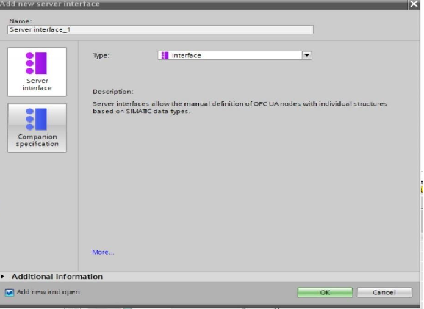
PLC Configuration with TIA Portal
3
OPC UA Server Setup
The PLC's OPC UA server is configured to allow remote access and communication with other components in the system.

Slide 6
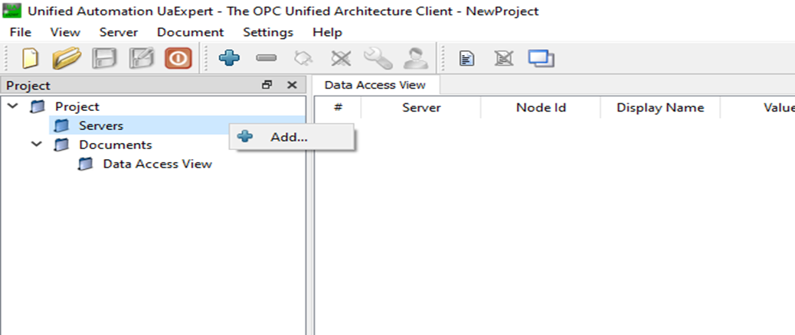
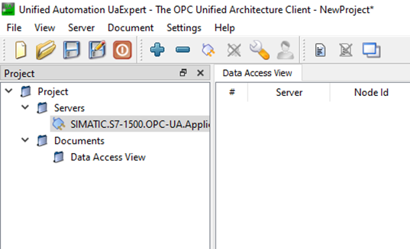
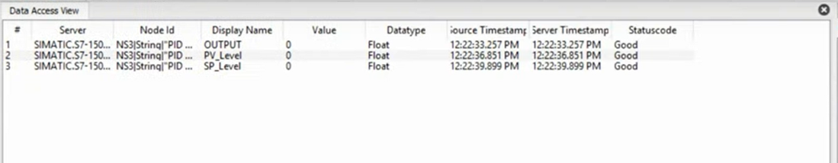
Data Extraction with UAExpert
Server Configuration
UAExpert is used to add the PLC as a server, with the server address copied from the TIA Portal properties and configured in the UAExpert interface.
Data Access
The required data tags from the PLC's data blocks are dragged and dropped into the UAExpert main screen, allowing for easy access and monitoring of the data.
Secure Connection
UAExpert handles the trust and certification process for the secure connection between the PLC and the data extraction components.

Slide 7
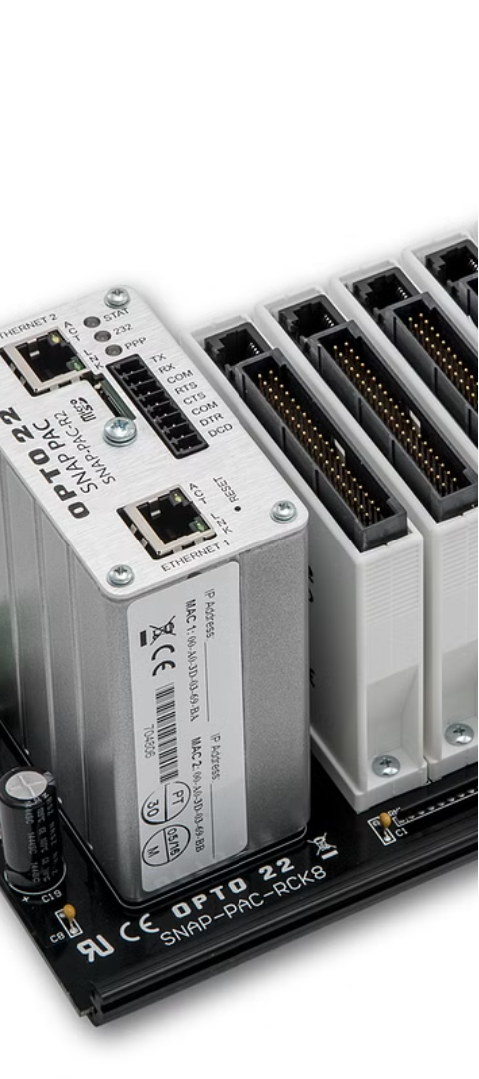



Data Processing with Node-RED
OPC UA Integration
Node-RED utilizes the OPC UA nodes to establish a connection with the PLC and extract the required data tags.
Data Transformation
The extracted data is transformed and formatted to be compatible with the InfluxDB time-series database for storage and visualization in Grafana.
InfluxDB Integration
The processed data is sent to the InfluxDB Cloud instance using the InfluxDB output node in Node-RED, ensuring reliable data storage and retrieval.

Slide 8
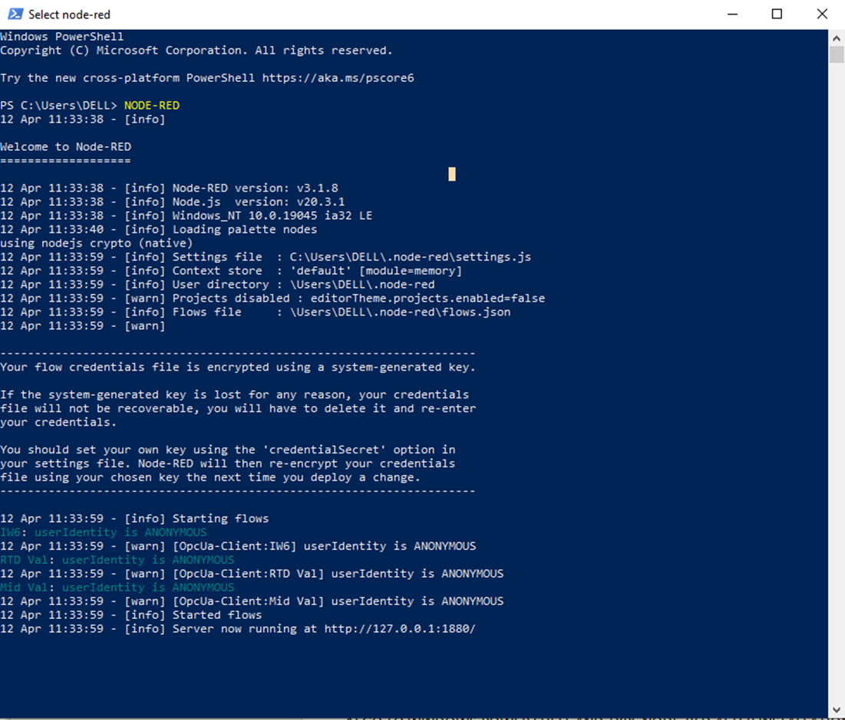
Node Red
Go to windows power shell and type node-red after installation.

Slide 9
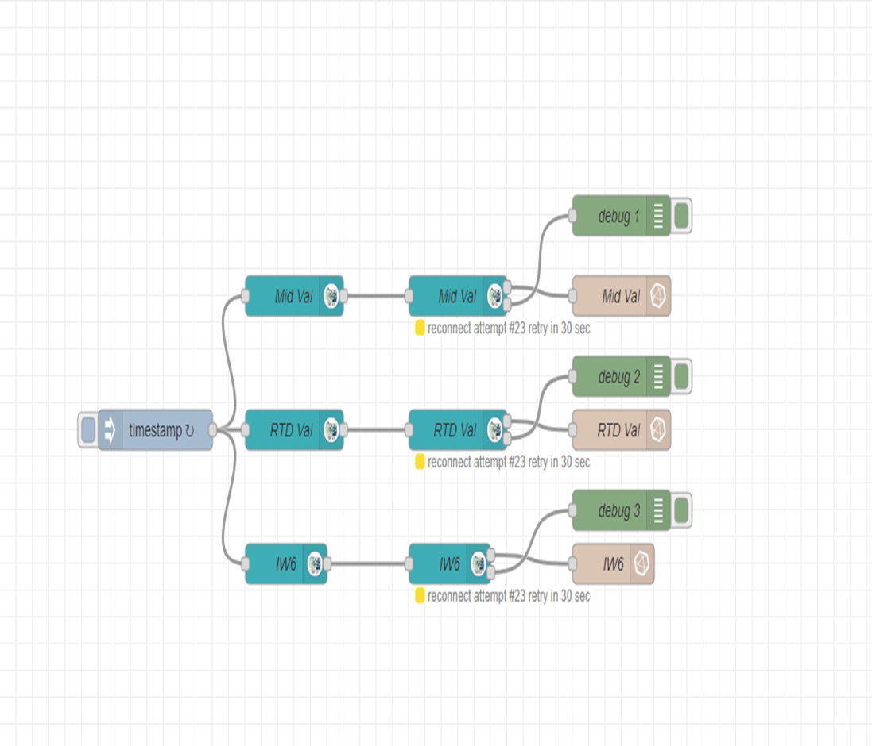
Node Red
2) Create your program

Slide 10
Data Storage and Visualization with InfluxDB and Grafana
InfluxDB Cloud
Grafana
Integrated Solution
The InfluxDB Cloud platform is used to store the time-series data collected from the PLC, providing a scalable and efficient data storage solution.
Grafana is leveraged to create dynamic dashboards and visualizations, allowing for comprehensive analysis and monitoring of the PLC data stored in InfluxDB.
The seamless integration of InfluxDB and Grafana enables the project to provide a powerful and user-friendly platform for real-time and historical data analysis and visualization.

Slide 11
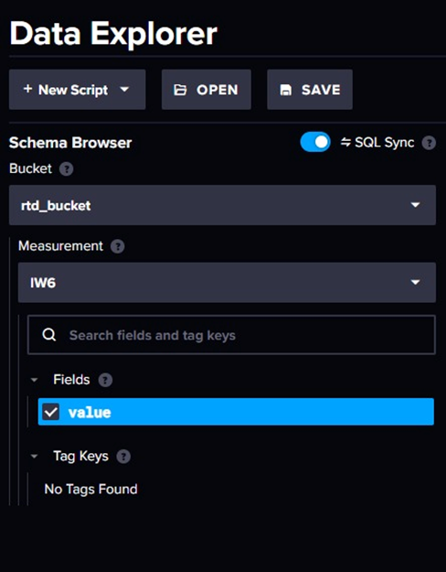
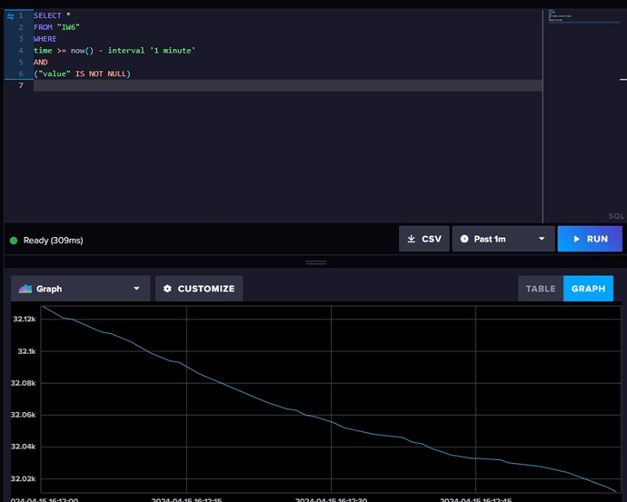
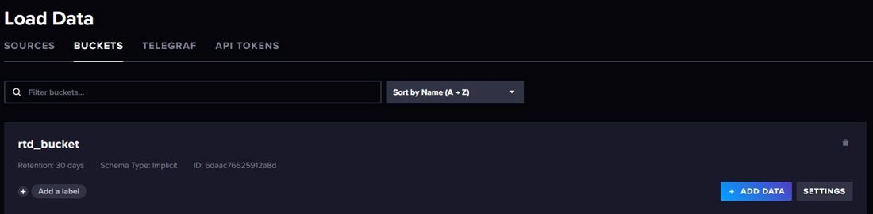
INFLUXDB CLOUD
Influx DB Cloud is a cloud-based platform that collects, stores, processes, and visualizes time series data. It's a real-time monitoring platform, dashboarding engine, analytics service, and event and metrics processor.
Click on the arrow on the top left > click on buckets.
2) Create bucket
3) Go to API tokens.
4) Give name to your token
5) Now go to node-red - search for influxdb out.
6) In Data Explorer, select your bucket, measurement and field.
7) Now you can see the graph of your PLC data, after you enter the SQL query and hit run.

Slide 12
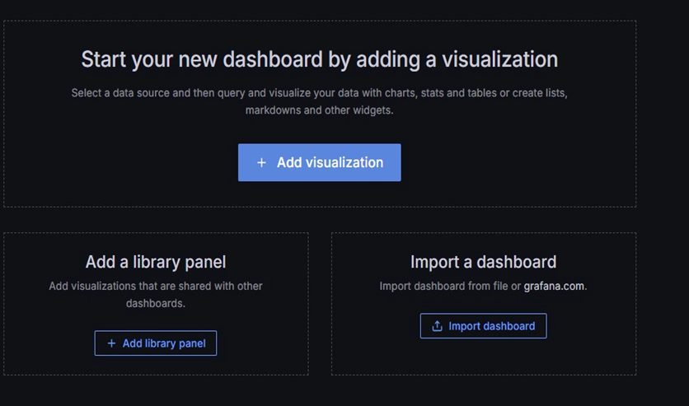
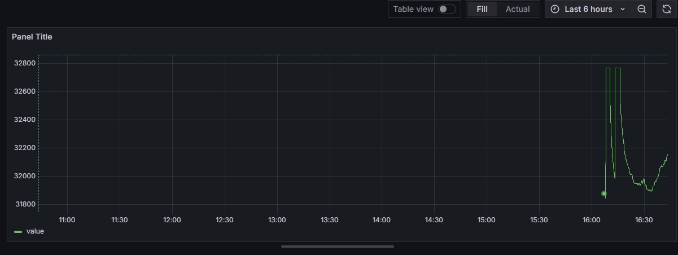
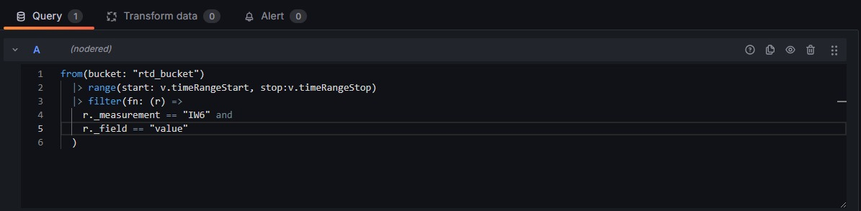
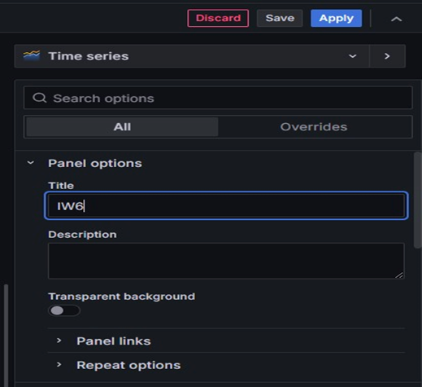
GRAFANA
1) Download andLog in into Grafana by using default username - admin and password - admin
2) Go to your datasource and click on Add Visualisation.
4) You can see the results on the window above.
3) Write your flux query.
5) Add title to your graph.

Slide 13
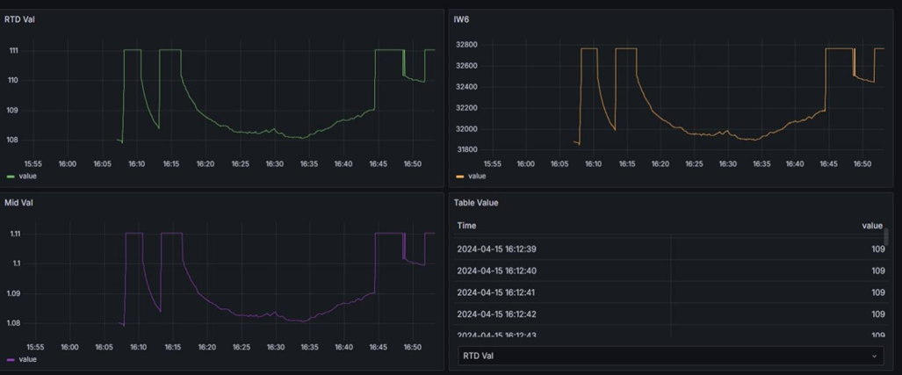
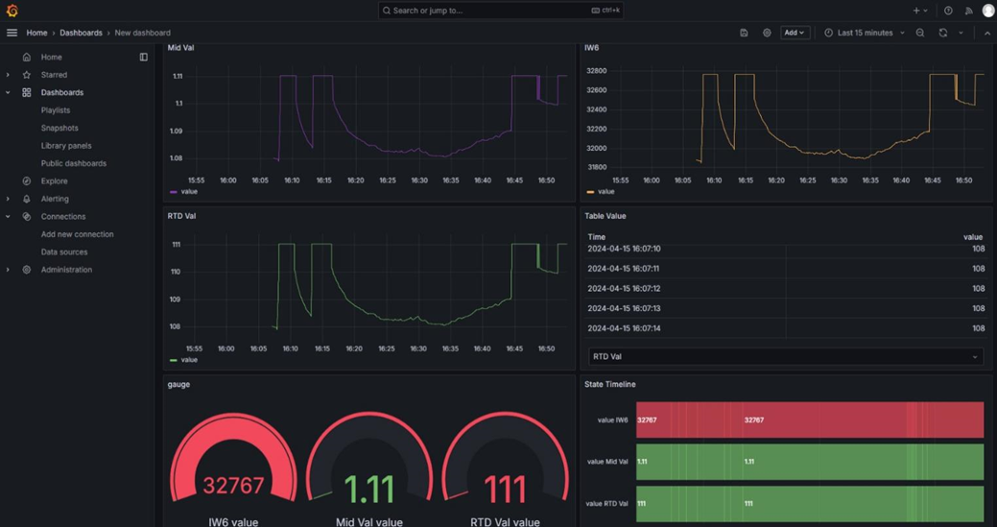
GRAFANA
6) Repeat the same process and create your dashboard.

Slide 14
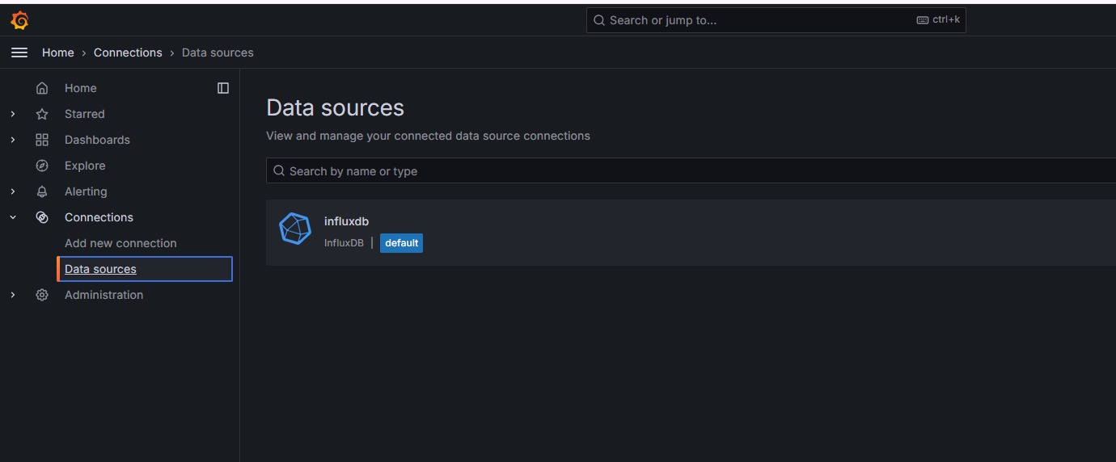
GRAFANA
Grafana steps to fill the form to complete the process

Slide 15
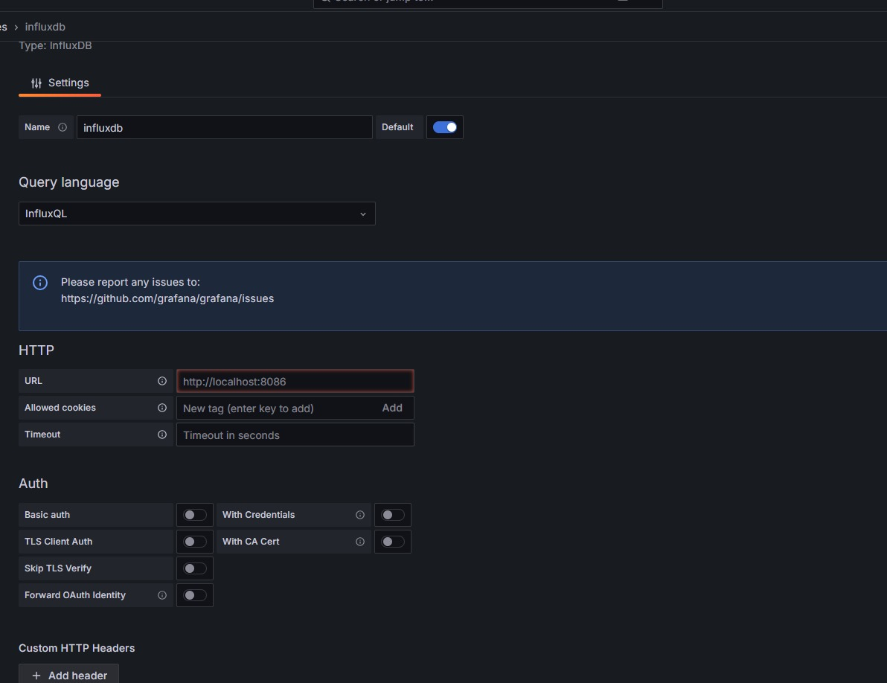
GRAFANA
Grafana form to completeing the fulfilling details

Slide 16
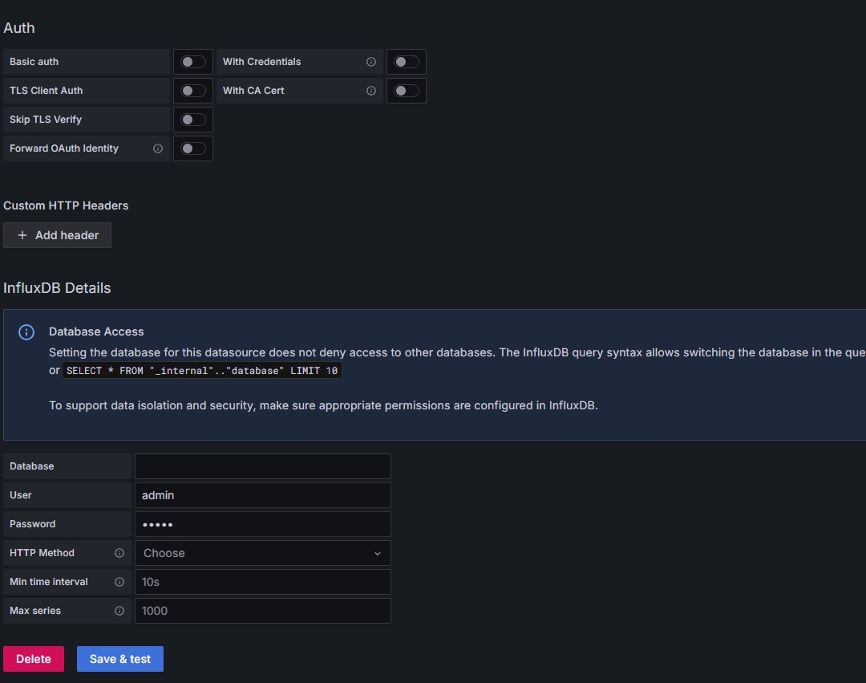
GRAFANA
Final steps save and test to display the value on final dashboard

Slide 17



Web-based Deployment
HTML Website
Google Drive Hosting
Remote Accessibility
The Grafana dashboard is embedded into an HTML website, providing a user-friendly and accessible interface for remote monitoring and analysis of the PLC data.
The website is hosted on Google Drive, allowing for easy deployment and public access to the PLC data visualization through a shareable link.
The web-based deployment enables remote access to the PLC data, empowering users to monitor and analyze the system from anywhere, enhancing the overall flexibility and accessibility of the solution.

Slide 18
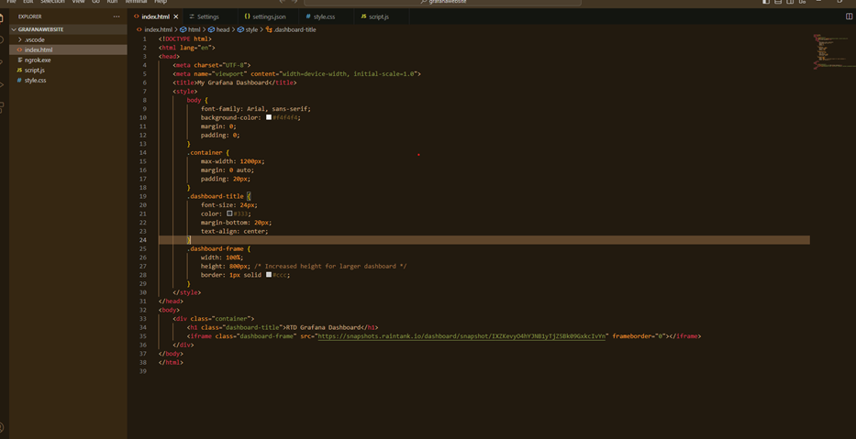
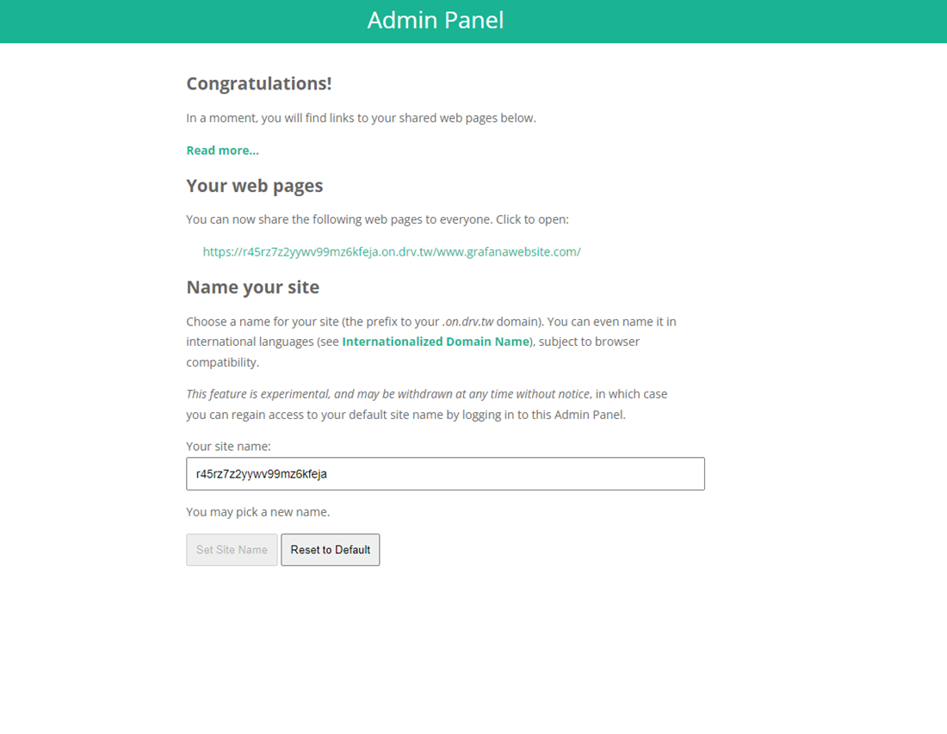
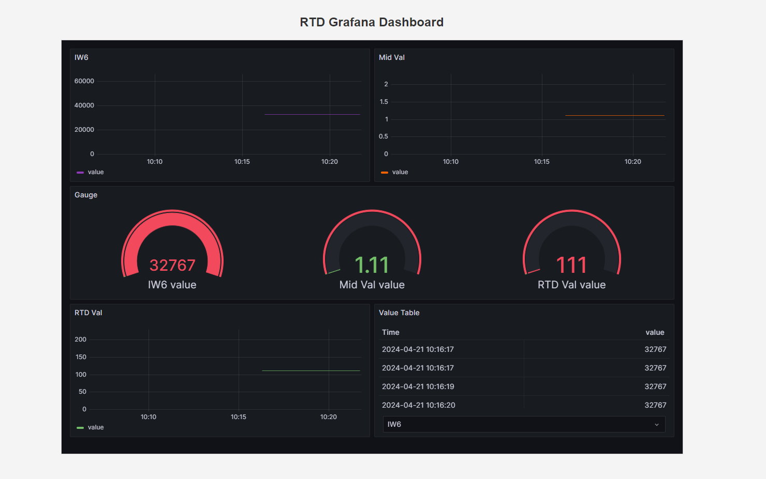
WEBSITE AND DEPLOYMENT
Write your HTML code to create the website on any text editor.
3) Give Public access to the drive folder.
4)Go to drv.tw and add your drive folder.
2) Right click and click on open live server and then you can see the website.

Slide 19
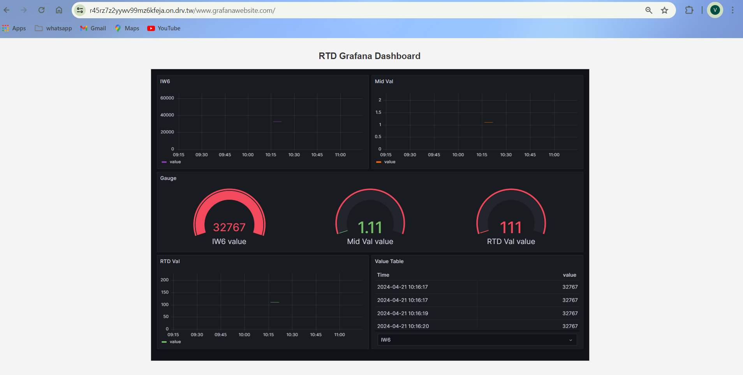
5) You will get a link to your live website !!!!! Click on it to access the dashboard remotely.+

Slide 20
THANKYOU

